Slide 1


Driver Drowsiness Detection System Using Machine Learning by 2111CS050068 - T.Abhinay 2111CS050113 - D.Nikhil 2111CS050092 - R.Pavan 2111CS050070 - J.Aryan Under the Guidance of Mrs.Affrose Department of Internet of Things School of Engineering Malla Reddy University Hyderabad, Telangana, INDIA

Slide 2
Contents
Abstract
Introduction
Literature Review
Problem Statement
Research Objectives
Implemetation
Results
Conclusions and Scope for future research
References

Slide 3
Abstract
Drowsy driving is one of the leading causes of traffic accidents all over the world. Driving in a monotonous manner for an extended amount of time without stopping causes tiredness and catastrophic accidents. Drowsiness has the potential to ruin many people's lives. As a result, a real-time system that is simple to create and configure for early and accurate sleepiness detection is required. In this study, a real-time vision-based system called Driver Drowsiness Detection System has been developed utilizing machine learning.It is a project built using Dlib and OpenCV with Python as a backend language.The project includes direct working with the 68 facial landmark detector and also the face detector of the Dlib library. The 68 facial landmark detector is a robustly trained efficient detector which detects the points on the human face using which we determine whether the eyes are open or they are closed.

Slide 4

Introduction
Drowsy driving stands as a pervasive and perilous issue contributing significantly to traffic accidents on a global scale.In response to this issue, the present study introduces a pioneering solution: the Driver Drowsiness Detection System. Leveraging the formidable capabilities of machine learning, this system constitutes a visionary advancement in vehicular safety. Developed through a synthesis of cutting-edge technologies including Dlib and OpenCV, with Python as the underlying programming language, this project is poised to revolutionize the landscape of driver fatigue mitigation.

Slide 5
Literature Review
Introduction to Drowsy Driving:
Drowsy driving is a significant global concern, contributing to a high number of traffic accidents. Researchers emphasize the need for effective preventive measures to address this issue.
Existing Studies on Drowsiness Detection:
Previous studies highlight the importance of early detection of drowsiness to mitigate potential accidents. Various approaches, including physiological sensors and machine learning algorithms, have been explored for this purpose.
Technological Solutions:
Technological interventions, particularly those utilizing computer vision and machine learning, have gained prominence in recent literature. These systems aim to detect early signs of driver fatigue by analyzing facial expressions and movements.

Slide 6
Role of Facial Landmark Detection:
The use of facial landmark detection, as seen in the 68 facial landmark detector of the Dlib library, has shown promise in identifying critical indicators of drowsiness, such as closed eyes. This approach has demonstrated effectiveness in real-time applications.
Challenges and Opportunities:
While advancements have been made in drowsiness detection systems, challenges such as balancing accuracy with simplicity and ensuring widespread usability persist. Future research opportunities lie in refining existing systems for practical implementation.

Slide 7
Problem Statement
Drowsy Driving is a Big Problem:
Lots of car crashes happen because drivers get really tired, especially during long and boring drives.Driving for a long time without a break makes drivers super tired, and that's when the chances of really bad accidents go up.
People's Lives Are in Danger:
Drowsy driving doesn't just mean more accidents; it means real people getting hurt or even losing their lives.When drivers are too tired, the accidents they cause don't just affect them—it's a big problem for everyone on the road.
We Need to Catch Sleepiness Early:
It's super important to notice when a driver is getting too tired early on.If we can tell when a driver is starting to feel really sleepy, we can help them before something really bad happens.
Using Smart Technology to Solve the Problem:
Our project is all about using smart computer stuff to stop accidents from tired driving.We're using special computer programs (like Dlib and OpenCV) to teach the computer to recognize when a driver is too sleepy.
Making Sure It Works Right and Everyone Can Use It:
The tricky part is making our system really good at telling if someone is sleepy, but also making it easy for everyone to use.It's not just about being smart; it's about being helpful for regular people so we can stop accidents caused by tired drivers.

Slide 8
Research Objectives
Develop a Real-Time Vision-Based System: Create a robust and efficient system that utilizes machine learning, Dlib, and OpenCV to detect and analyze facial landmarks in real-time.
Accurately Identify Facial Landmarks: Implement the 68-point facial landmark detector to precisely locate key points on the human face, enabling accurate assessment of eye openness.
Implement Blink Analysis Algorithm: Design and implement a blink analysis algorithm to classify blinks into distinct categories, including active, drowsy, and asleep, based on eye movement patterns.
Utilize Machine Learning for Classification: Train the system with labeled datasets to leverage machine learning algorithms for automated classification of blink patterns, enhancing accuracy and adaptability to varying driving conditions.
Provide Early and Accurate Sleepiness Detection: Develop a system that can detect signs of drowsiness promptly, allowing for timely interventions to prevent accidents caused by driver fatigue.
Evaluate System Performance: Conduct comprehensive testing and validation to assess the system's accuracy, responsiveness, and reliability under various real-world driving scenarios.

Slide 9
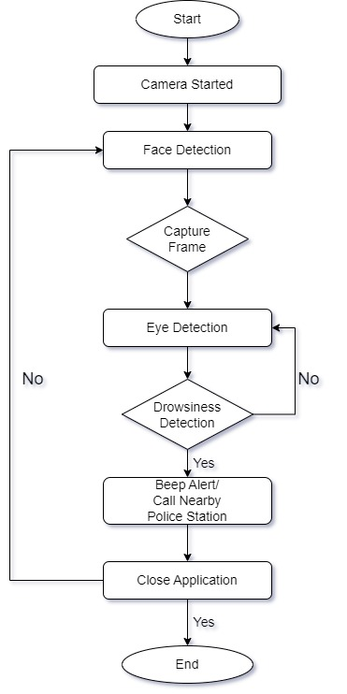
Implementation
Block Diagram

Slide 10
Work in detail
1. Video Input:
- The system begins by capturing a video feed from the device's camera. In this implementation, OpenCV is used to access the video stream.
2. Face Detection:
- Utilizing the Dlib library, the system applies a frontal face detector to identify and locate faces within the video frames. The detector identifies the coordinates of the bounding box around the face.
3. Facial Landmark Detection:
- Once a face is detected, the 68-point facial landmark detector is employed. This module identifies 68 specific points on the face, including eyes, nose, mouth, etc.
4. Blink Analysis:
- The system calculates the blink ratio by measuring the ratio of eye closure to eye opening. This ratio is used to determine if the eyes are open, closed, or in a transitional state.
- The `blinked()` function computes the blink ratio based on the distances between key points.
5. Classification:
- Based on the blink ratio, the system classifies blinks into three categories: active blinks, drowsy blinks, and closed eyes indicative of sleepiness.

Slide 11
6. Status Determination:
- The system keeps track of the consecutive occurrences of different blink states (active, drowsy, or asleep). If a certain threshold is crossed, it updates the status to reflect the driver's condition.
7. Display and Feedback:
- The system overlays the status message ("Active :)", "Drowsy !", or "SLEEPING !!!") on the video feed to provide real-time feedback to the user.
8. Result Display:
- Additionally, the system displays a window showing the face with detected landmarks and the bounding box around it, aiding in visualizing the detection process.
9. User Interaction:
- The system continually updates the display and waits for user input to exit the program.

Slide 12
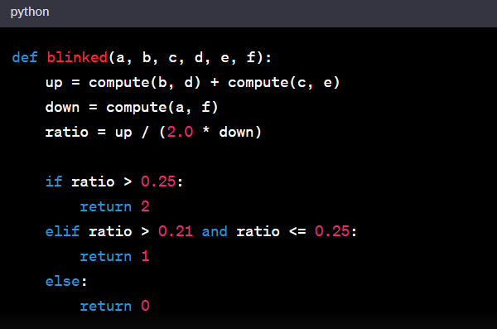
Algorithm
Here P1, P2, P3, P4, P5, P6 are the pupil coordinates EAR is generally a constant when eyes are open and is near about 0.25. When EAR is between 0.25 and 0.21 It is concluded that Person is drowsy. When EAR is less than 0.21 It is concluded that Person is sleeping.
Eye Aspect Ratio(EAR) is calculated for both the eyes,
(|P2 − P6| + |P3 − P5|)
_______________________________
2(|P1 − P4|)
The numerator determines the distance between the upper and lower eyelids using equation 1. The horizontal distance of the eye is represented by the denominator. EAR values are utilised to identify driver sleepiness in this framework. The average of the EAR values of the left and right eyes is obtained. The Eye Aspect Ratio is watched in our sleepiness detection system to see whether the value falls below the threshold value and does not climb over the threshold value in the following frame. The individual has closed their eyes and is sleepy, as indicated by the aforementioned circumstance. In contrast, if the EAR value rises again, it means that the person is simply blinking his eyes and is not drowsy

Slide 13
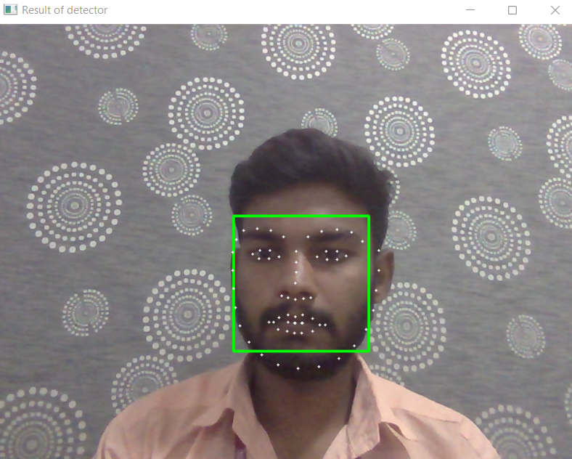

Results
Shape Predictor-68 Face Landmarks
Person is Active :)

Slide 14


Results
Person is Drowsy !
Person is Sleeping !!!

Slide 15
Conclusion
In conclusion, the Driver Drowsiness Detection System represents a significant step forward in addressing the critical issue of drowsy driving. Through the integration of machine learning and vision-based techniques, this system provides a real-time, accurate, and easily implementable solution to detect early signs of driver fatigue.
By leveraging the power of facial landmarks and blink analysis, the system offers a non-intrusive means of monitoring driver alertness. The utilization of Dlib and OpenCV libraries, along with the 68-point facial landmark detector, demonstrates the effectiveness and robustness of this approach.
This project not only holds the potential to save lives by preventing accidents caused by drowsy driving but also contributes to the ongoing efforts to enhance road safety. The system's adaptability and scalability make it a valuable addition to the arsenal of technologies aimed at safeguarding individuals on the road.

Slide 16
Scope for future research
Integration with Advanced Sensors:
Explore the integration of additional sensors such as infrared cameras or EEG sensors to enhance the accuracy and reliability of drowsiness detection. These sensors can provide supplementary data for a more comprehensive assessment of the driver's alertness.
Dynamic Environmental Adaptation:
Investigate methods to adapt the system to different driving conditions, including variations in lighting, weather, and road conditions. This would ensure optimal performance across a wide range of real-world scenarios.
Multi-Modal Data Fusion:
Explore the potential of combining data from multiple sources, such as facial landmarks, physiological signals, and vehicle telemetry, to create a comprehensive driver monitoring system. This holistic approach may provide a more nuanced understanding of driver behavior.
Real-Time Intervention Strategies:
Develop mechanisms for real-time interventions to mitigate the risks associated with drowsy driving. This could include auditory or visual alerts, seat vibrations, or even automated adjustments to the vehicle's driving mode.
Long-Term Driver Profiling:
Implement techniques for long-term driver profiling to understand individual variations in drowsiness patterns. This could lead to personalized interventions and recommendations tailored to specific drivers.

Slide 17
References
1. Shrivastava, A., & Pandey, M. (2019). Driver drowsiness detection system: A review. In 2019 IEEE Calcutta Conference (CALCON) (pp. 214-218). IEEE.
2. Zhang, Y., Zhang, C., Liu, W., & Huang, C. (2017). Real-time eye blink detection using facial landmarks. In 2017 IEEE International Conference on Multimedia & Expo Workshops (ICMEW) (pp. 306-311). IEEE.
3. King, D. A. (2007). Dlib-ml: A machine learning toolkit. Journal of Machine Learning Research, 8, 1755-1758.
4. Bradski, G., & Kaehler, A. (2008). Learning OpenCV: Computer vision with the OpenCV library. " O'Reilly Media, Inc.".
5. Al-Maadeed, S., & Bouridane, A. (2015). Drowsy driver detection: A review. Image and Vision Computing, 40, 23-37.
6. Viola, P., & Jones, M. J. (2004). Robust real-time face detection. International Journal of Computer Vision, 57(2), 137-154.
7. Abdi, H., & Williams, L. J. (2010). Principal component analysis. Wiley Interdisciplinary Reviews: Computational Statistics, 2(4), 433-459.
8. Schuster, M., & Paliwal, K. K. (1997). Bidirectional recurrent neural networks. IEEE Transactions on Signal Processing, 45(11), 2673-2681.

Slide 18

Thank You
Thank You

